Slide 1
Mobile Game Development
By Joshua Barnes

Slide 2
Initial idea
To develop a simulation game.
Farming game that follows some core mechanics similar to games like: Hay Day and Farmville.
The difference being that this game will involve mini games that take advantage of controls only mobile devices have.

Slide 3
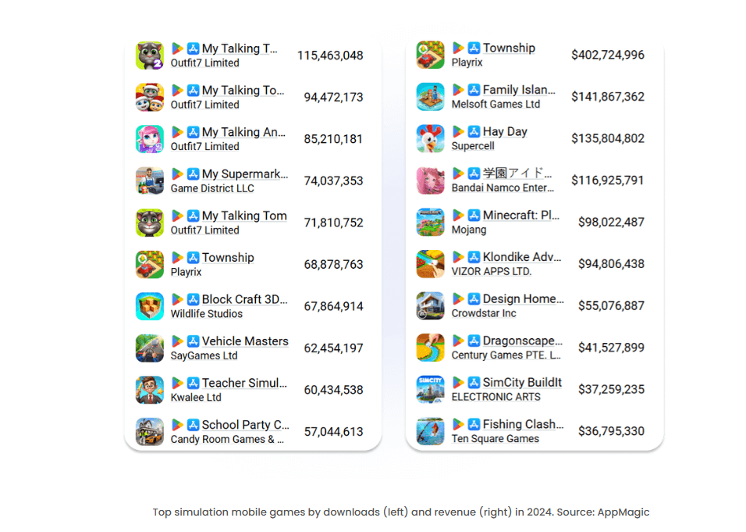
Why simulation?
The following image shows the downloads of simulation games and the revenue made.
200+ Mobile Gaming Market Statistics [2025 Report] shows that simulation and puzzle were the most downloaded mobile game genres
The difference which intends to make this game stand out is using unique features contained only on mobile devices.

Slide 4
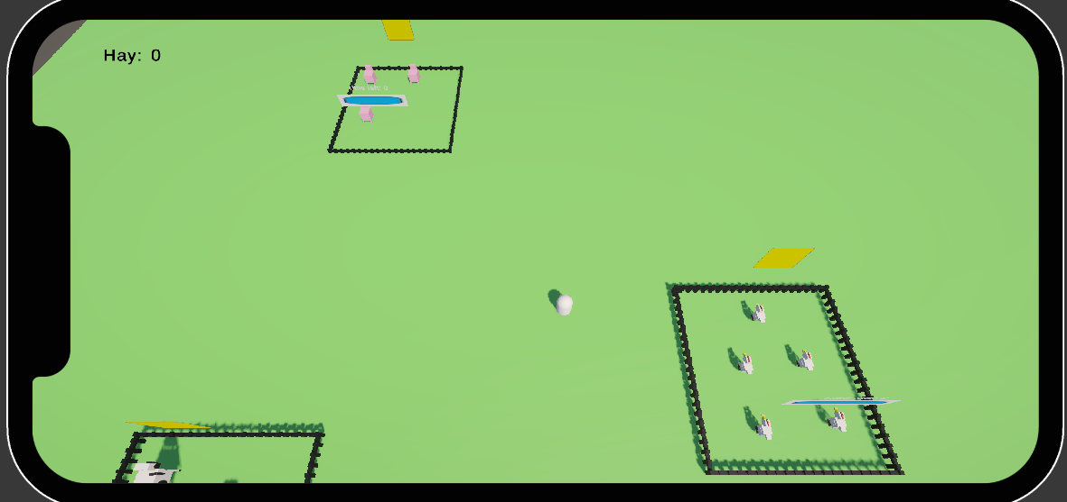
Core Features
Game involves building your own farm.
Farm will include animal pens and crops which can be harvested after a certain amount of time.
Farmers will act as helpers to help maintain the farm such as cleaning and gathering.
Buying and selling systems in place to provide currency.
Currency used to purchase more on the farm.

Slide 5
Advanced features
Game will include mini games that will rely on unique mechanics such as the phone's gyro or accelerometer.
Users will be allowed to view their farm in AR.
Ads will be utilised for a method of monetisation.
It will also include a premium currency which can be bought with real money – microtransactions.

Slide 6
UI
Game will first open with a loading screen that will be immersive and interactive to draw the user in.
The game will use bright colour palates to keep the game visually pleasing.
Everything in the farm will be interactive when pressed.

